Slide 1
Requirements Document for the Banking System
Lecture # 40

Slide 2
Requirements Document
The requirements document is a formal document used to communicate the requirements to customers, engineers and managers
It is also known as software requirements specifications or SRS

Slide 3
Requirements Document
The services and functions which the system should provide
The constraints under which the system must operate
Overall properties of the system i.e., constraints on the system’s emergent properties

Slide 4
Today’s Topics
In this lecture, we’ll discuss the requirements document of the Banking system that we have been talking about in this course
Let’s develop a template based on the IEEE standard

Slide 5
SRS for the Banking System
Preface
Introduction
Glossary
Specific requirements
Appendices
  Use-case model
  Object model
  Data-flow model

Slide 6
SRS for the Banking System
Preface
  This should define the expected readership of the document and describe its version history including a rationale for creation of a new version and a summary of the changes made in each version
Introduction
  This should define the product in which the software is embedded, its expected usage and present an overview of the functionality of the control software

Slide 7
SRS for the Banking System
Glossary
  This should define all technical terms and abbreviations used in the document
Specific requirements
  This should define specific requirements for the system using natural language with the help of diagrams, where appropriate
Appendices
  Use-case model
  Object model
  Data-flow model

Slide 8
Software Requirements Specifications for the Banking System

Slide 9
1. Preface
This document, Software Requirements Specification (SRS), is created to document the software requirements for the Banking System, as described in section 2, Introduction, of this document

Slide 10
1. Preface
This document was created on the request of the ‘XYZ Bank Inc.’ – the ‘Client’. The creator of this document is ‘A Software House Inc.’ – ‘Vendor’. The ‘Client’ has asked the ‘Vendor’ to develop an SRS for the Banking System. The ‘Vendor’ will also be responsible for the development of the software based on this SRS

Slide 11
1. Preface
This is the first version of the SRS.

Slide 12
2. Introduction
This section documents an overview of the functionality expected from the software for the Banking System
We’ll review the functionality of the software to be developed

Slide 13
2. Introduction
A bank has several automated teller machines (ATMs), which are geographically distributed and connected via a wide area network to a central server. Each ATM machine has a card reader, a cash dispenser, a keyboard/display, and a receipt printer. By using the ATM machine, a customer can withdraw cash from either checking or savings account, query the balance of an account, or transfer funds from one account to another. A transaction is initiated when a customer inserts an ATM card into the card reader. Encoded on the magnetic strip on the back of the ATM card are the card number, the start date, and the expiration date. Assuming the card is recognized, the system validates the ATM card to determine that the expiration date has not passed, that the user-entered PIN (personal identification number) matches the PIN maintained by the system, and that the card is not lost or stolen. The customer is allowed three attempts to enter the correct PIN; the card is confiscated if the third attempt fails. Cards that have been reported lost or stolen are also confiscated.

Slide 14
2. Introduction
If the PIN is validated satisfactorily, the customer is prompted for a withdrawal, query, or transfer transaction. Before withdrawal transaction can be approved, the system determines that sufficient funds exist in the requested account, that the maximum daily limit will not be exceeded, and that there are sufficient funds available at the local cash dispenser. If the transaction is approved, the requested amount of cash is dispensed, a receipt is printed containing information about the transaction, and the card is ejected. Before a transfer transaction can be approved, the system determines that the customer has at least two accounts and that there are sufficient funds in the account to be debited. For approved query and transfer requests, a receipt is printed and card ejected. A customer may cancel a transaction at any time; the transaction is terminated and the card is ejected. Customer records, account records, and debit card records are all maintained at the server.

Slide 15
2. Introduction
An ATM operator may start up and close down the ATM to replenish the ATM cash dispenser and for routine maintenance. It is assumed that functionality to open and close accounts and to create, update, and delete customer and debit card records is provided by an existing system and is not part of this problem.

Slide 16
3. Glossary
ATM: Automated Teller Machine
PIN: Personal Identification Number

Slide 17
4. Specific Requirements
The XYZ Bank Inc. can have many automated teller machines (ATMs), and the new software system shall provide functionality on all ATMs.
The system shall enable the customers of XYZ Bank Inc., who have valid ATM cards, to perform three types of transactions; 1) withdrawal of funds, 2) Query of account balance, and 3) transfer of funds from one bank account to another account in the same bank.

Slide 18
4. Specific Requirements
An ATM card usage shall be considered valid if it meets the following conditions:
  The card was issued by an authorized bank.
  The card is used after the start date, i.e., the date when the card was issued.
  The card is used before the expiration date, i.e., the date when the card expires.
  The card has not been reported lost or stolen by the customer, who had been issued that card.
  The customer provides correct personal identification number (PIN), which matches the PIN maintained by the system.

Slide 19
4. Specific Requirements
The system shall confiscate the ATM card if it detects that a lost or stolen card has been inserted by a customer. The system shall also display an apology to the customer.
The system shall allow the customer to enter the correct PIN in no more three attempts. The failure to provide correct PIN in three attempts shall result in the confiscation of the ATM card.

Slide 20
4. Specific Requirements
The system shall ask for the transaction type after satisfactory validation of the customer PIN. The customer shall be given three options: withdrawal transaction, or query transaction, or transfer transaction.
If a customer selects withdrawal transaction, the system shall prompt the customer to enter account number and amount to be dispensed.

Slide 21
4. Specific Requirements
For a withdrawal transaction, the system shall determine that sufficient funds exist in the requested account, that the maximum daily limit has not be exceeded, and that there are sufficient funds available at the local cash dispenser.

Slide 22
4. Specific Requirements
If a withdrawal transaction is approved, the requested amount of cash shall be dispensed, a receipt shall be printed containing information about the transaction, and the card shall be ejected. The information printed on the receipt includes transaction number, transaction type, amount withdrawn, and account balance.

Slide 23
4. Specific Requirements
If a customer selects query transaction, the system shall prompt the customer to enter account number.
If a query transaction is approved, the system shall print a receipt and eject the card. The information contained on the receipt includes transaction number, transaction type, and account balance.

Slide 24
4. Specific Requirements
If a customer selects transfer transaction, the system shall prompt the customer to enter from account number, to account number, and amount to be transferred.
The system shall check if there are enough funds available in the from account, which are being requested for transfer to the to account.

Slide 25
4. Specific Requirements
If the transfer transaction is approved, a receipt shall be printed and card shall be ejected. The information printed on the receipt includes transaction number, transaction type, amount transferred, and account balance.
The system shall cancel any transaction if it has not been completed if the customer presses the Cancel button

Slide 26
4. Specific Requirements
The customer records, account records, and debit card records will all be maintained at the server and shall not be the responsibility of the system.
The system shall enable an ATM operator to shutdown or start up an ATM for routine maintenance.

Slide 27
4. Specific Requirements
The system shall enable an ATM operator to add cash to the cash dispenser.
The system shall not be responsible for opening or closing of accounts, and to create, update, and delete customer and debit card records. These tasks are performed elsewhere by a bank.

Slide 28
4. Specific Requirements
The system shall be linked with the bank server through communication systems, which are beyond the scope of the current system. It is assumed that this facility is always available.
The system shall not be responsible for the maintenance of the hardware devices of the ATM or network facilities.

Slide 29
5. Appendices
5.1 Use-case model
5.2 Object model
5.3 Functional model
  5.3.1 Data-flow model
  5.3.2 SADT model
5.4 Dynamic model
  5.4.1 Statecharts
  5.4.2 Interaction diagrams

Slide 30
Use Case Model

Slide 31
Uses Case Diagram for ATM Customer
Withdraw
funds
«include»
Validate
PIN
ATM
Customer
«include»
Query
account
«include»
Transfer
funds

Slide 32
Use Case Diagram for ATM Operator
Add
cash
Startup
Operator
Shutdown

Slide 33
Use Case Diagram for ATM
Withdraw
funds
«include»
Validate
PIN
ATM
Customer
«include»
Query
account
«include»
Transfer
funds
Add
cash
Startup
Operator
Shutdown

Slide 34
Object Model

Slide 35
Conceptual Static Model for Problem Domain: Physical Classes
Maintains
ATM
Operator
1
1
1
1
1
1
ATMCustomer
CardReader
CashDispenser
ReceiptPrinter
1
1
1
Reads
Dispenses
Prints
1
1
1
ATMCard
ATMCash
Receipt

Slide 36
Conceptual Static Model for Problem Domain: Entity Classes
1
Maintains
1
Bank
ATMInfo
Has
1
1
1..*
1
Manages
Customer
Identifies
Owns
1..*
Owns
Provides
access to
1..*
0..1
1..*
*
1..*
Modifies
DebitCard
Account
ATMTransaction
1,2
*
CardAccount

Slide 37
Banking System Context Class Diagram
1
Operator
CardReader
1..*
1
1
ReceiptPrinter
1..*
1
1
Interacts
with
Banking
System
1
1
Operator
1
1
1..*
1
ATMCustomer
1..*
ATM
Customer
1
CashDispenser
1
1..*

Slide 38
Banking System: Major Subsystems
ReceiptPrinter
1
Operator
1
Banking
System
1
1
1
CardReader
1
ATMClient
Subsystem
1..*
1
BankServer
Subsystem
1
1
1
CashDispenser
1
ATMCustomer

Slide 39
Banking System External Classes and Interfaces Classes
Banking
System
1
1
1
CardReader
Interface
CardReader
1
Receipt
Printer
Interface
Operator
Interface
ReceiptPrinter
1
1
Operator
1
1
1
1
1
ATMCustomer
1
1
ATMCustomer
Interface
1
ATM
Customer
1
1
CashDispenser
Interface
Operator
CashDispenser
1

Slide 40
ATM Client Subsystem Classes
ATMClientSubsystem
CardReader
Interface
ATMControl
Customer
Interface
ATMTransaction
ReceiptPrinter
ATMCard
Operator
Interface
CashDispenser
Interface
ATMCash

Slide 41
Data Flow Diagrams

Slide 42
System Context Diagram
Inputs
from
Customer
ATM
Customer
Bank
Requests
Cash
Outputs
to
Customer
Receipt
0
ATM
System
Bank
Operator
Instructions
Bank
Responses
ATM
Operator
Operator
Responses

Slide 43
Data Flow Diagram – Level 1
Inputs
from
Customer
ATM Card
and
Transactions
Messages
to Bank
Interface
Bank
Requests
Cash
2
Interface
with
Customer
Messages
from
Customer
Interface
1
Control
ATM
4
Interface
with
Bank
Receipt
Bank
Responses
Messages to
Customer Interface
Messages
from Bank
Interface
Outputs
to
Customer
Messages from
Operator Interface
Messages to
Operator Interface
ATM
Cash
3
Interface
with
Operator
Operator
Instructions
Operator
Responses

Slide 44
Level 2 DFD: Interface with Customer
Card
Info
ATM Card
and
Transactions
Cash
Eject
Card
2.1
Read and
Validate
Card
2.3
Dispense
Cash
Dispense
Cash
Confiscate
Card
1
Control
ATM
Card
Inserted
ATM
Cash
Transaction
Info
User Input
Read
Print
Receipt
Cancelled
2.4
Print
Receipt
2.2
Process
User Inputs
and Display
PIN
Display
Message
Cancel
Display
Messages
Receipt

Slide 45
Level 2 DFD: Interface with Operator
Shutdown
ATM
1
Control
ATM
3.2
Display
Messages
Shutdown/Startup
Started
Display
Messages
3.1
Process
Operator
Inputs
Cash to be
Replenished
Replenish
Cash
Operator
Responses
Restart
ATM
3.3
Update
ATM Cash
DB
ATM
Cash
Cash Amount
Cash Details

Slide 46
Level 2 DFD: Interface with Bank
ATM Card
and
Transactions
Confiscate
Card
Validate
Card
Eject
Card
Card
Validation
Request
Card
Valid
4.1
Validate
Card
Dispense
Cash
1
Control
ATM
Transaction
Rejected
Invalid
Card
Card
Validation
Response
4.2
Process
Transaction
Transaction
Approved
Card
Inserted
Lost/Stolen
Card
Transaction
Request
Transaction
Response

Slide 47
SADT Diagrams

Slide 48
Banking System Context Diagram
ATM Usage
Terms and
Conditions
Bank
Approvals
Lost/Stolen
Cards List
Card Info
Cash
PIN
Transaction Info
Display
Messages
ATM System
Cancel
Receipt
Operator
Instructions
A-0
Software Tools
and Databases
Networks

Slide 49
SADT Level 1 Diagram
ATM Usage
Terms and
Conditions
Bank
Approvals
Lost/Stolen
Cards List
Card Info
Cash
PIN
Display
Messages
Perform
ATM Services
Transaction Info
Receipt
Cancel
A-1
Software Tools
and Databases
Networks

Slide 50
SADT Level 2
ATM Usage
Terms and
Conditions
Lost/Stolen
Cards
ATM
Conditions
Bank
Approvals
Card
Info
Read & Validate
Card
Dispense
Cash
Cash
Valid
Card
Info
A-1-1
A-1-3
PIN
Process
Request
Display
Messages
Transaction Info
Cancel
A-1-2
ATM
Conditions
Receipt
Data
Print
Receipt
Receipt
A-1-4

Slide 51
SADT Level 1 Diagram
ATM Usage
Terms and
Conditions
Shutdown
Message
Perform
Operator
Services
Startup
Message
Display
Messages
Cash
Amount
A-2

Slide 52
Statecharts

Slide 53
Statechart for ATM Control: Validate PIN Use Case
1.2: Card Inserted /
1.3: Get PIN
Idle
Waiting
for PIN
Entry / Display
Welcome
2.4: PIN Entered /
2.5: Validate PIN
Validating PIN
2.6: Valid PIN /
2.7: Display Menu,
2.7a: Update Status
Waiting for
Customer Choice

Slide 54
Statechart for ATM Control: Withdraw Funds Use Case
Idle
Terminating
Entry / Display
Welcome
3.18: Card Ejected /
3.19: Display Ejected
Ejecting
Waiting for
Customer Choice
3.15: Receipt Printed /
3.16: Eject
Printing
3.3: Withdrawal Selected /
3.4: Request Withdrawal,
3.4a: Display Wait
3.10: Cash Dispensed /
3.11: Print Receipt,
3.11a: Display Cash Dispensed,
3.11b: ACK Cash Dispensed
Processing
Withdrawal
3.5: Withdrawal OK /
3.6: Dispense Cash,
3.6a: Update Status
Dispensing

Slide 55
Top-Level ATM Control Statechart
Closed Down
Insufficient Cash / Eject
Entry / Display
System Down
After (Elapsed Time)
[Closedown Was Requested]
Startup
Closedown
1.2: Card Inserted /
1.3: Get PIN
Idle
After (Elapsed Time)
[Closedown Not Requested]
Entry / Display
Welcome
Processing
Customer
Input
Third Invalid, Stolen / Confiscate, Update Status
Terminating
Transaction
Cancel / Eject, Display Cancel
Rejected /
Eject, Display Apology
Transfer Selected /
Request Transfer,
Display Wait
Query Selected /
Request Query,
Display Wait
Transfer OK / Print Receipt,
Update Status
Query OK / Print Receipt,
Update Status
Processing
Transaction
3.3: Withdrawal Selected /
3.4: Request Withdrawal,
3.4a: Display Wait
3.5: Withdrawal OK /
3.6: Dispense Cash, 3.6a: Update Status

Slide 56
ATM Control Statechart: Processing Customer Input Superstate
1.2: Card Inserted /
1.3: Get PIN
Idle
Entry / Display
Welcome
Cancel /
Eject,
Display Cancel
Waiting for PIN
Processing
Customer
Input
2.4: PIN Entered /
2.5: Validate PIN
Invalid PIN /
Invalid PIN Prompt,
Update Status
Third Invalid, Stolen /
Confiscate,
Update Status
Validating PIN
Transfer Selected /
Request Transfer, Display Wait
2.6: Valid PIN /
2.7: Display Menu,
2.7a: Update Status
Query Selected /
Request Query, Display Wait
Waiting for Customer Choice
3.3: Withdrawal Selected /
3.4: Request Withdrawal,
3.4a: Display Wait

Slide 57
ATM Control Statechart: Processing Transaction Superstate
Rejected / Eject,
Display Apology
Processing Transaction
Transfer Selected /
Request Transfer,
Display Wait
Processing
Transfer
Transfer OK /
Print Receipt,
Update Status
Query Selected /
Request Query,
Display Wait
Processing
Query
Query OK /
Print Receipt,
Update Status
3.3: Withdrawal Selected /
3.4: Request Withdrawal,
3.4a: Display Wait
Processing
Withdrawal
3.5: Withdrawal OK /
3.6: Dispense Cash,
3.6a: Update Status

Slide 58
ATM Control Statechart: Terminating Transaction Superstate
Idle
Closed Down
After (Elapsed Time) [Closedown Was Requested]
After (Elapsed Time)
[Closedown Not Requested]
Entry / Display
System Down
Terminating
Transaction
Terminating
Cancel / Eject,
Display Cancel
Card Confiscated /
Display Confiscate
3.18: Card Ejected /
3.19: Display Ejected
Third Invalid, Stolen /
Confiscate, Update Status
Ejecting
Confiscating
Rejected / Eject,
Display Apology
3.15: Receipt Printed /
3.16: Eject
Transfer OK /
Print Receipt,
Update Status
Printing
Query OK /
Print Receipt,
Update Status
3.10: Cash Dispensed /
3.11: Print Receipt,
3.11a: Display Cash Dispensed,
3.11b: ACK Cash Dispensed
3.5: Withdrawal OK /
3.6: Dispense Cash,
3.6a: Update Status
Dispensing
Insufficient Cash / Eject

Slide 59
Collaboration Diagrams

Slide 60
Collaboration Diagram: ATM Client Validate PIN Use Case
:BankServer
1: Card
Reader
Input
1.2: Card
Inserted
:CardReader
:CardReader
Interface
2.5: Validate PIN
(Customer Info)
2.6: [Valid]
Valid PIN
1.1: Card
Input Data
:ATM
Control
2.4: PIN Entered
(Customer Info)
:ATMCard
1.3: Get
PIN
2.7a: Update
Status
2.2: Card
Data
2.1: Card
Request
2.7: Display
Menu
1.4: PIN Prompt
2.8: Selection Menu
:Customer
Interface
:ATM
Transaction
2: PIN Input
2.3: Customer Info

Slide 61
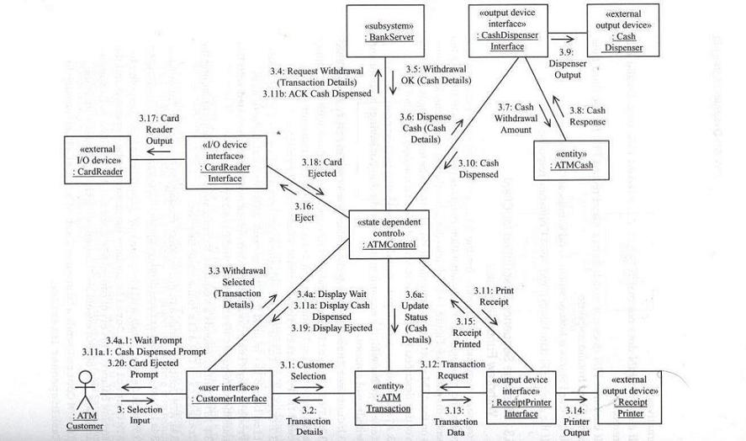
Collaboration Diagram: ATM Client Withdraw Funds Use Case

Slide 62
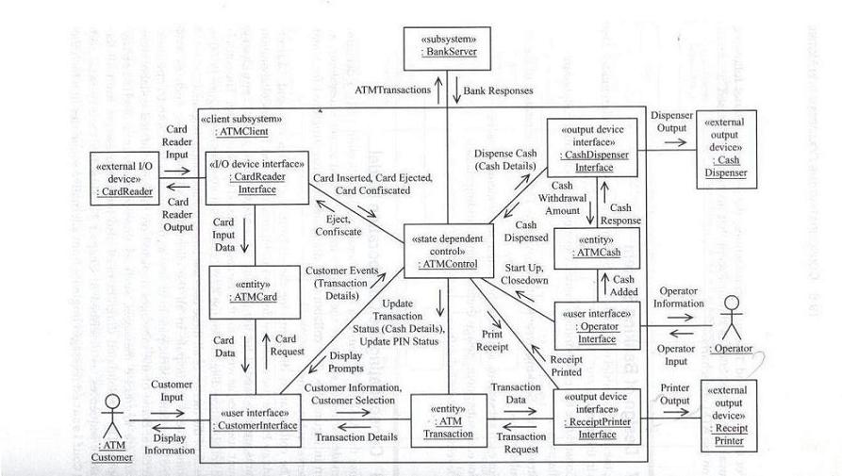
Consolidated Collaboration Diagram for ATM Client Subsystem

Slide 63
Sequence Diagram

Slide 64
Sequence Diagram: ATM Client Validate PIN Use Case - 1
:CardReader
Interface
:ATMCard
:ATMControl
:Customer
Interface
:ATM
Transaction
:BankServer
:ATM
Customer
1: Card
Reader Input
1.1: Card Input Data
1.2: Card Inserted
1.3: Get PIN
1.4: PIN Prompt

Slide 65
Sequence Diagram: ATM Client Validate PIN Use Case - 2
:CardReader
Interface
:ATMCard
:ATMControl
:Customer
Interface
:ATM
Transaction
:BankServer
:ATM
Customer
2: PIN Input
2.1: Card Request
2.2: Card Data
2.3: Customer Info
2.4: PIN Entered
2.5: Validate PIN
2.6: [Valid]: Valid PIN

Slide 66
Sequence Diagram: ATM Client Validate PIN Use Case - 3
:CardReader
Interface
:ATMCard
:ATMControl
:Customer
Interface
:ATM
Transaction
:BankServer
:ATM
Customer
2.7: Display Menu
2.7a: Update Status
2.8: Selection Menu

Slide 67
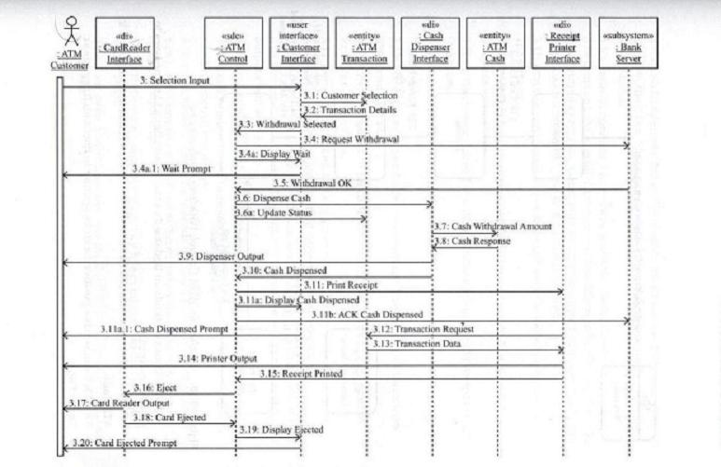
Sequence Diagram: ATM Client Withdraw Funds Use Case

Slide 68
Summary
Up till now we have completed the analysis, requirements modeling, and specification of requirements for the banking system case study
We have formally completed the requirements document for the case study

Slide 69
References
‘Requirements Engineering: Processes and Techniques’ by G. Kotonya and I. Sommerville, John Wiley & Sons, 1998
‘Designing Concurrent, Distributed, and Real-Time Applications with UML’ by H. Gomaa, Addison-Wesley, 2000

